Slide 2
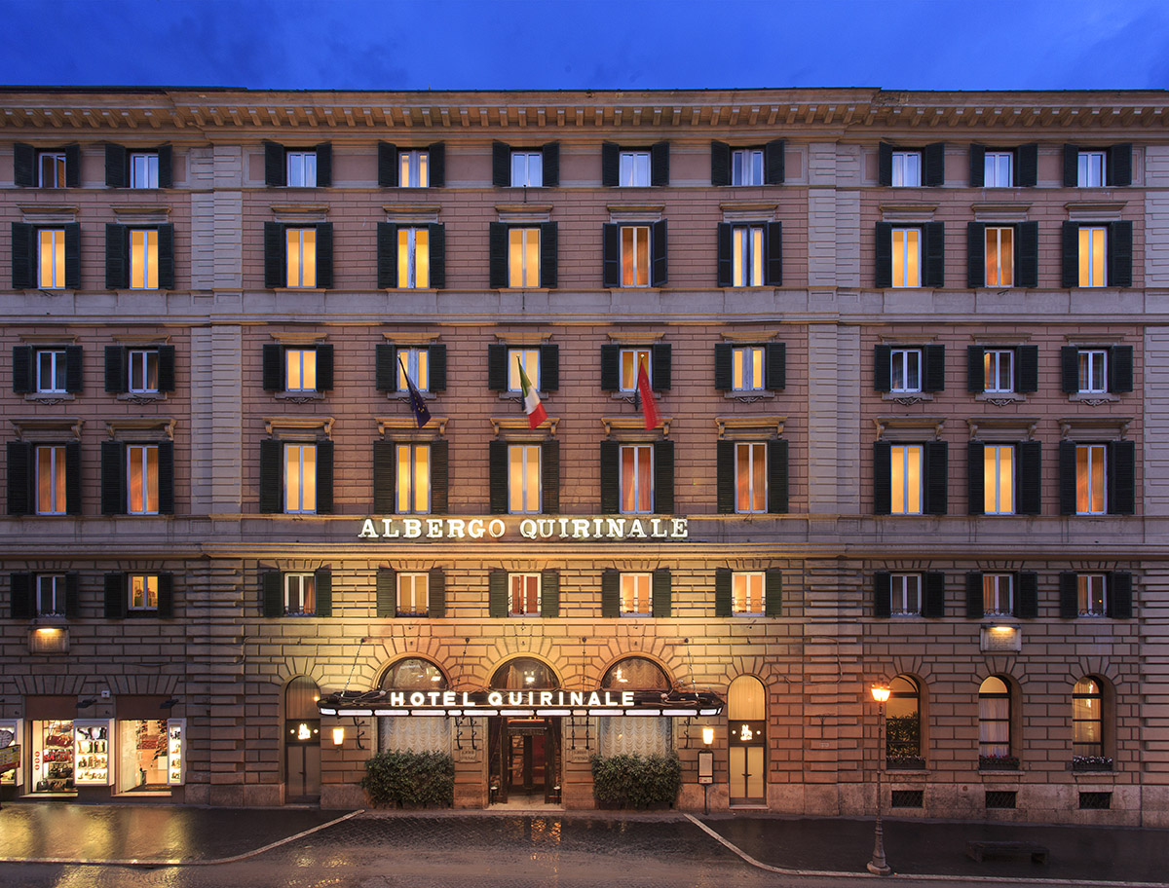

Slide 3
Hotel quirinale BACK TO THE PAST TO LIVE THE PRESENT
Historical and business hotel in the city center
4 stars
209 Rooms & Suites
5 meeting rooms – banquets up to 250 pax
Rossini Restaurant – Full day dining
Cocktail Bar
Terrace
Private garden
Exercise corner

Slide 4
